Slide 1
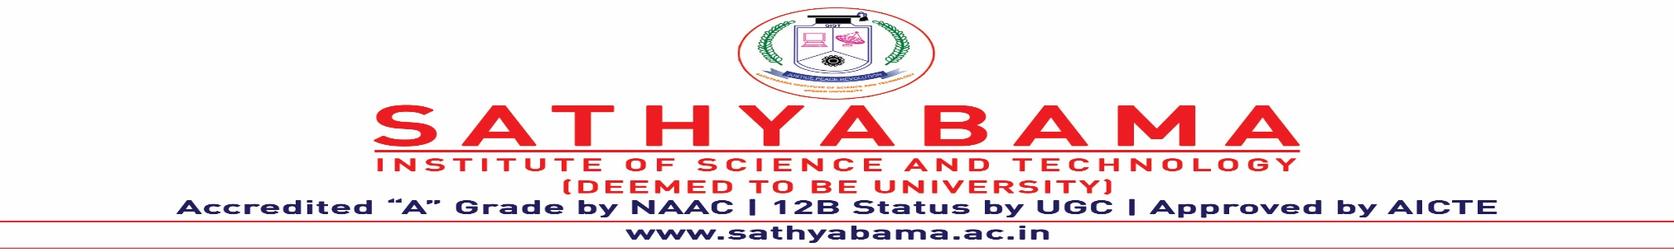

SITA1502 CIDD
UNIT-5
UX AND UI

Slide 2
UNIT 5 UX AND UI
UX Introduction -Elements of UX Design- UX Design Process- Research Methods and Tools-Understanding User Needs and Goals. UX Design Process: Visual Design Principles-Information Design and Visualization-Interaction Design- Prototyping Tools-Usability Test. UI Introduction-User Interface Components -Tools and Processes.

Slide 3
UX Introduction
UX Design is studying user behaviour and understanding user motivations with the goal of designing better digital experiences. UX designers do far more than sketch out where a button should appear on a web page.
Systems that confuse, intimidate or infuriate their users don’t have flawed users, but flawed designs that need to be fixed.

Slide 4
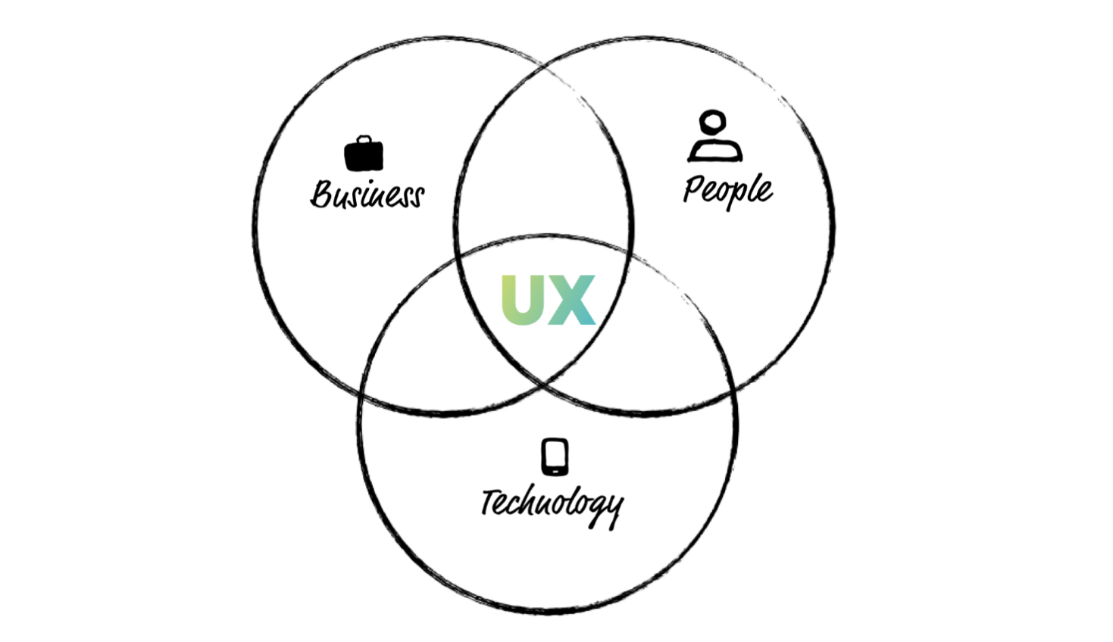

Slide 5
Balancing business requirements
While focusing on user needs it is also important for a UX Designer to be aware of balancing business goals with technology constraints (or opportunities).
While it is true that a product cannot succeed without a healthy business, a business cannot succeed without a happy customer — and it is the UX Designer’s job to be the customer advocate.
Customers don’t often get invited to meetings, so don’t be afraid to speak up on their behalf.

Slide 6
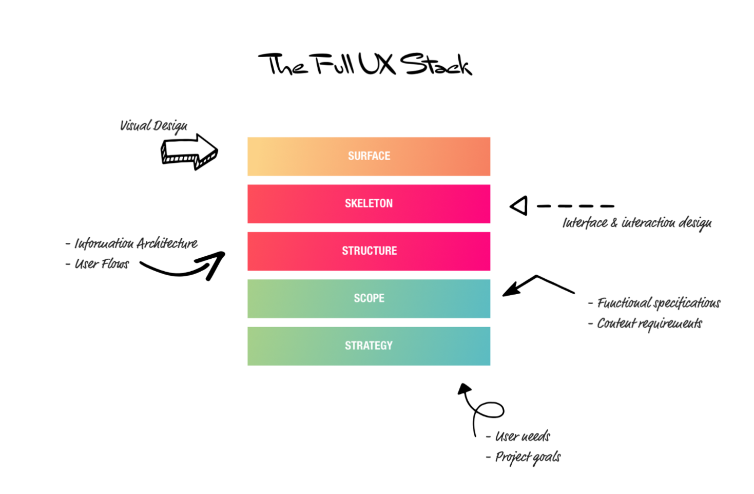

Slide 7
Let’s walk through the full UX Stack to see what questions UX can help the team answer, starting with the initial strategy and scope phases where the concept is taking shape. UXD can answer some fundamental business questions:
Do users need the product you are making?
Do they want it enough that they will either pay for it or if it is free, spend time looking for it and learning to use it?
Are you missing a key feature they will need?
Are you spending time building features they will never use?

Slide 8
Next, once we have decided what to build we need to decide how. It is in the structure and skeleton phases where the project really takes shape and a good UXD can help answer some critical implementation questions:
How should the content be organised so that users can easily find it?
Will users find your app easy to use? Where do they get confused or lost?
What content is needed and how should it be written to be most engaging?

Slide 9
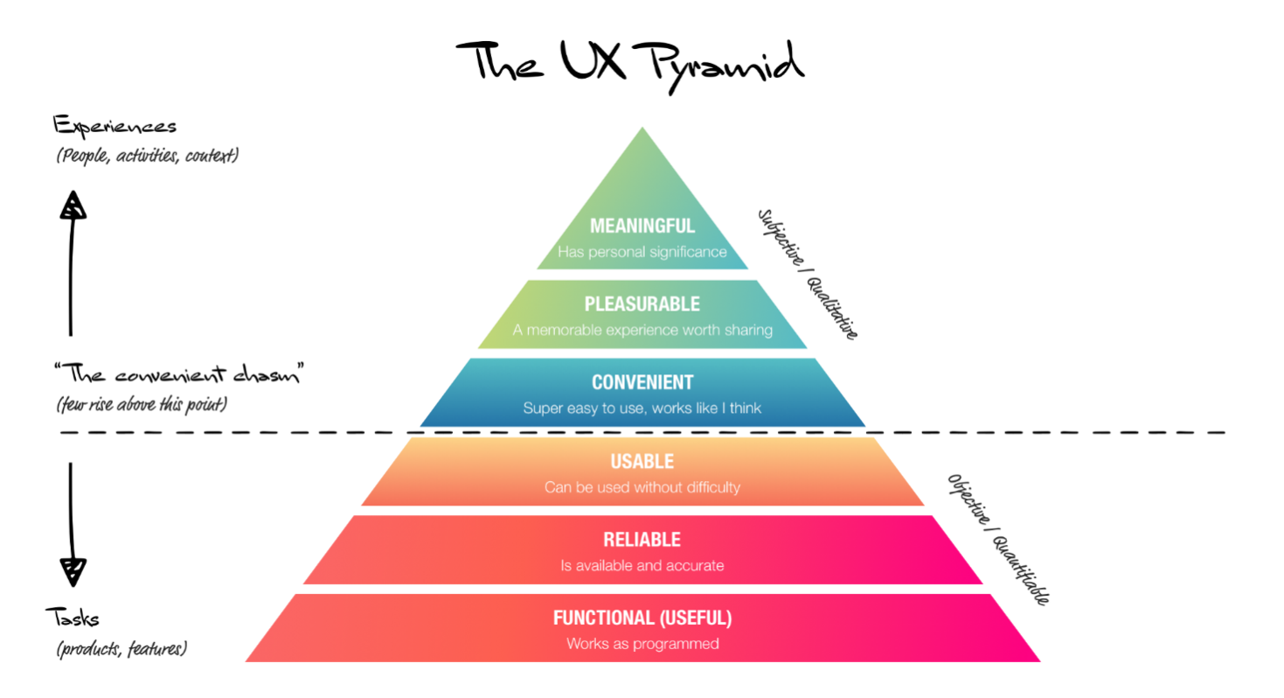

Slide 10
The UX Pyramid
With such a broad and varied definition, it can be difficult to find ways to benchmark or measure User Experience. The UX Pyramid is an excellent framework for categorising UX effort and tracking progress.
Based on Maslow’s hierarchy of needs, the base of the UX Pyramid lays the foundation with fundamentals (breathing, in Maslow’s case), before advancing to higher, more enriching user experiences. Levels 1 to 3 of the Pyramid concentrate on a user’s ability to achieve a desired task.

Slide 11
Level 1: Functional Does it work?
Characteristics:
No bugs, errors and outages
Uses current technologies (doesn’t rely on old technologies like Flash that don’t work on phones or tablets)
It has some purpose; someone has a need for it
Includes all key features
Works in all modern browsers
Passes basic accessibility

Slide 12
Level 2: Reliable Is it available and accurate?
Characteristics:
Loads in reasonable time, even in peak periods
Content is current and accurate
Data is clean and reliable
Password resets are sent/received promptly
It can be used effectively on mobile devices and standard device types

Slide 13
Level 3: Usable Can it be used without difficulty?
Characteristics
Users don’t get lost or confused
Users can easily find the content or products they are interested in
The site doesn’t rely on constant help messages or long instruction manuals
It has a short learning curve
Users don’t rely on ‘hacks’ or workarounds to use it
Call centres aren’t swamped with basic enquiries
Meets basic UX heuristics and best practice

Slide 14
Level 4: Usable Can it be used without difficulty?
Characteristics
Users don’t get lost or confused
Users can easily find the content or products they are interested in
The site doesn’t rely on constant help messages or long instruction manuals
It has a short learning curve
Users don’t rely on ‘hacks’ or workarounds to use it
Call centres aren’t swamped with basic enquiries
Meets basic UX heuristics and best practice

Slide 15
Level 5: Pleasurable Is it an enjoyable experience that’s worth sharing?
Characteristics
Users invest themselves into it
Users promote, share and evangelise it
It becomes part of the user’s regular routine

Slide 16
Level 6: Meaningful Does it have personal or social significance?
Characteristics
Users it brings meaning to their life
Diagnosing and solving UX issues
There are three main strategies for improving the UX of a design or system.

Slide 17
Elements of UX Design
When you want to make or buy something while on a website, you make decisions. Analysing the key elements of UX, you will better understand how these decisions are made. By meeting the needs of users, we motivate them to stay on the website, engage in interaction and be more satisfied.
There are five key elements of UX.
All 5 steps are dependent on each other and the whole process goes from bottom to top.

Slide 18
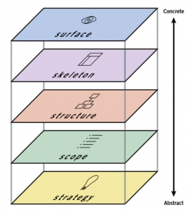

Slide 19
The strategy defines the reason why an application or product exists, why you are doing the whole business, who you are doing and why people would use it.
The main goal here is to define the needs of users and business goals.
This can be done through a strategic research where potential users would be interviewed on one side, and business needs would be adjusted on the other

Slide 20


Slide 21
Volume
The scope defines the functional and content requirements. What features and content should contain the product. Requirements should meet strategic goals.
Functional requirements – related to the functioning of the entire side, as certain parts work together.
These are the characteristics that the user needs to store to achieve a specific goal. Content requirements – the information we need to give value to what we do (text, images, video).

Slide 22


Slide 23
Structure
The structure defines the user’s interaction with the product, the behaviour of the whole system, how it is organized, and how much it should be displayed at a given moment.
There are two structural components: interactive design & information architecture. Interactive design – when functional features are already defined, defines the user’s relationship with the product as a system that needs to respond to given user requests.

Slide 24
Excellent Interactive design:
Helps users meet their goals;
Has effective interactivity and functionality (what the user can do);
It informs the user about changing conditions while on the page (file has been saved, feedback when the wrong email has been entered, etc.);
Prevents errors when the application requires confirmation from the user for a potentially harmful effect (eg deletion).

Slide 25
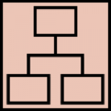

Slide 26
The skeleton determines the visual form of the screen and presents all the elements that need to be interacted. Shows how the user moves through information and how the information is presented to be clear, effective, and obvious. Wireframes are widely used to create a visual format.
It is actually a static diagram that presents the visual format of the product, which includes content, navigation, and all forms of interaction. The skeleton is divided into three parts: Design of the interface, design of navigation and information design.

Slide 27
Interface design – presenting and editing elements so they can act with the functionality of the application; Navigation Design – the way of navigating through the information; Information Design – presentation of the information in an easily understandable way.
The skeleton should answer the following questions:
What visual forms should be presented on the screen? How can interactions be presented and divided? How can a user move around the site or application? How can the content be clearly presented?

Slide 28
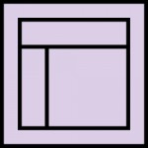

Slide 29
Area
The last step. It refers to how your product, typography, colours, the actual layout, and so on will look.
The goal is to simplify things, be easy to understand and the user to absorb the necessary information.
It is necessary to visually present the entire content and buttons, for the user to know what can do and how to communicate with them.

Slide 30


Slide 31
UX Design Process
User experience (UX) refers to the interaction a user has with a product or service and the experience they have with it. It is in fact a person’s feelings, attitude and emotions they feel while using any product or service.
User experience (UX) design is an Empathy driven process of designing a product or service that are useful, easy to use, and delightful to interact with it.
UX Design process is a process of solving User Problem. It is an iterative method which helps a UX Designer to continuously improve and polish designs based on User Feedback.

Slide 32
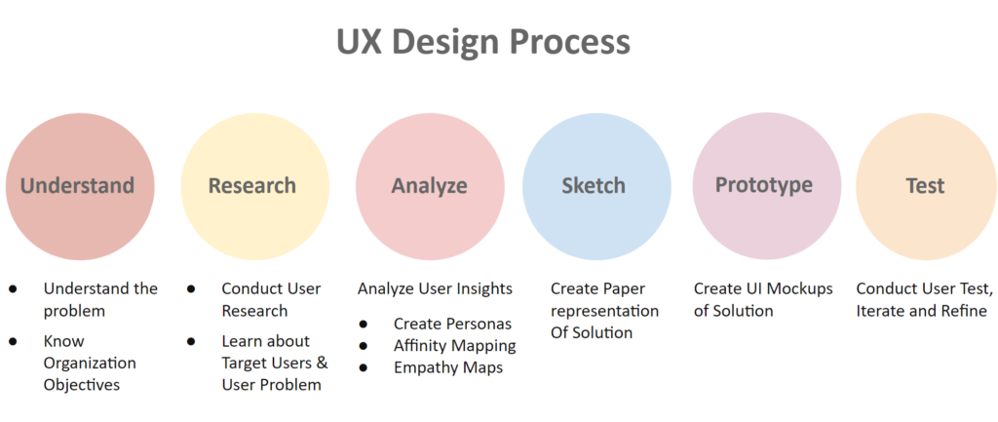

Slide 33
Step 1: Understand
UX design is the process of solving a problem for user so that they can achieve their goals easily. In order to do this, the first step is to understand the problem you would solve and the objectives of the organization as well.

Slide 34


Slide 35
There can be multiple ways to do this
If you working for an agency then ask your clients
Working for an organization then ask the stakeholders
Ask for previous research conducted which can include market research, User research, competitor analysis, etc.)
Speak to the Product Managers as well
Analyse requirements to understand and clarify them
Getting understanding about two elements is crucial

Slide 36

Step 2: Research
User Experience (UX) research- serves many purposes throughout the design process. It not just helps us to get a clear picture of about users, but also answers key questions like what users think and why they do what they do.

Slide 37
Qualitative Research
Exploratory form of the research where the researcher collects verbal, behavioural or observational data which is interpreted to get insights. Most common methods are
1. Focus Groups
Focus Group brings together 6-9 Participant users. The Goal of the Test is to discover what users want from the Product.
Furthermore, conducting Focus Groups allows you to learn about their attitude, opinion and reactions to concepts that you are testing with Users.
2. Contextual Interview
A contextual interview involves one-on-one interaction between user and researcher. And the interaction involves the researcher to watch and observe the user work in their environment; and then discuss those activities with them.

Slide 38
3. User Interview
User interview is one of the most common User research methods. In fact, it provides you the rich information and insights of what your target users think about your new product, site or service.
A User Interview is typically conducted by 2 UX researchers, one to conduct the interview and other to record the interview and take notes.
4. Ethnography Study
Ethnography is a kind of social research. It is type of qualitative research which provides a detailed and in-depth description of everyday life and practice taking a wider picture of culture.

Slide 39
Step 3:Analyse
After you have conducted your Research, you would a plethora of insights which can be quantitative or qualitative. In the next step you have to analyse the information gathered and make connections around it so that you draw some conclusions.

Slide 40
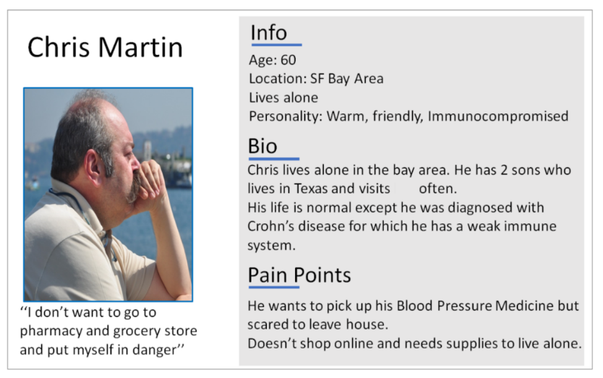
1. Creating User Personas
User Persona is a fictional yet realistic representation of Target user of the product. Creating User Personas helps you to identify what the user requirements by understanding their needs, experiences, behaviours and goals.

Slide 41
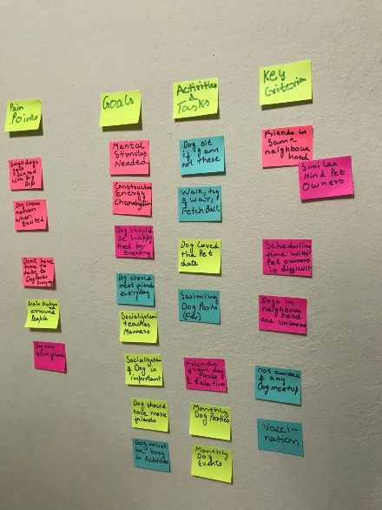
2. Affinity Mapping
Affinity Mapping is about finding the user needs from the observations gathered. The goal is to synthesize information gathered into common themes and patterns to discover interesting findings which will help in defining user focused Problem and creating design solution.

Slide 42
User Journey Map
User Journey map talks about the complete path a User takes while interacting with your company which starts from the awareness stage when they realize they have a need, through all the points of interaction with your brand, and the moment they are satisfied (or not).

Slide 43
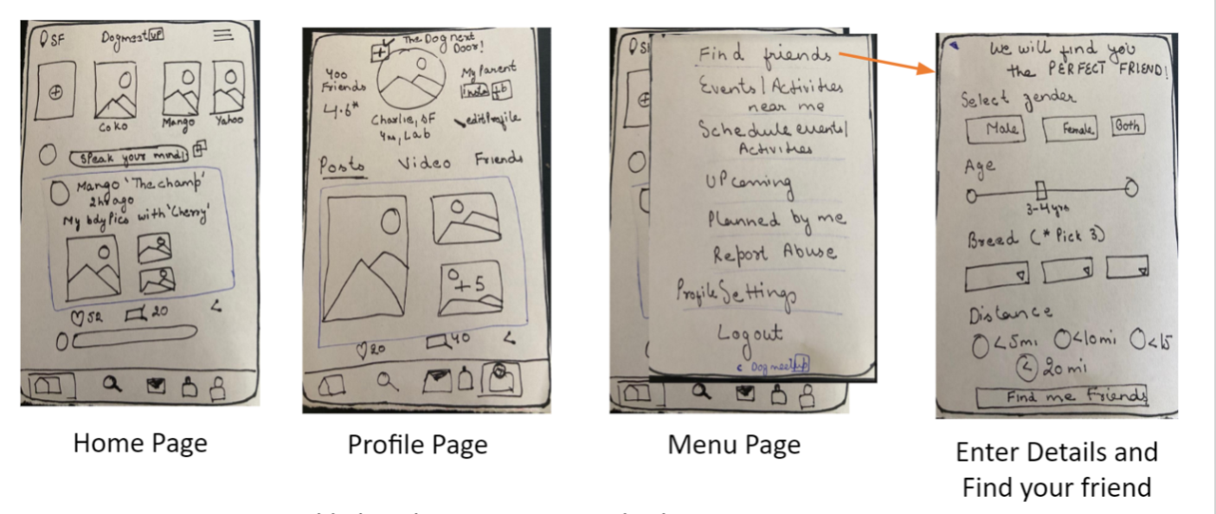
Step 4: Sketch Designs
Now, it’s time to actually define how the content on each page should be organized. Furthermore, you have to define how these pages would work together in a way that for user finds that they find the design it intuitive and easy to navigate.
Easiest way to do this is by creating Paper Sketches. Infect creating paper sketches and Prototyping on paper is a quick and cost-effective way to test ideas in the early stages of Product development.

Slide 44
Step 5: Test Design and Iterate
This feedback will form the basis for further iterations and refinement. You must learn about how they feel and think about it. Learn how they interact with the prototype. Pay attention on the User interactions.
So, Test the Design, get a constructive feedback and iterate it. Get as much critical feedback you can as it will help you to move faster in the Design Process. Additionally, it saves time, effort and money by catching bugs errors usability issues, that you might not have anticipated.

Slide 45
Research Methods and Tools
Gathering user data and feedback is a hectic and maddening process, especially if you’re in the middle of pushing out new builds.
But UX research methods serve as a way of streamlining the task a bit and making the data you get more readable.

Slide 46
Interviews Is sitting down with users and asking them extensive questions an old-fashioned and time-consuming method to get information?
Yes, it surely is. But is it also highly effective at getting answers that the user wouldn’t provide to an automated test-box? You know it is or I wouldn’t be mentioning these as a viable method.

Slide 47
It is important to mention that getting solid information requires the skills of a trained interviewer. I’m no good at these, for example, but some of my colleagues are a godsend when it comes to handling in code Group’s users.
Without interviews, we wouldn’t know about some small issues with our early designs because users often tend to omit things when filling out automated response forms. Some do it out of laziness, some don’t want to harp on the problems too much, and some are just plain bored by the unending survey form.

Slide 48
Automated Surveys Oh, uhm, so about that time when I said survey forms are unending and not always as effective.
They are, sure, but they can also be a great way of getting info on things that an interviewer simply wouldn’t think to ask. If a user is willing to engage with a lengthy survey, chances are you’ll get some excellent data out of them.
And even a short one can target the particular questions that are rote and usually omitted in interviews. It might seem like an extra step (and, technically, sure, it is) but you never know which question will bring you that 9gold nugget of info that you need for a breakthrough in your design.

Slide 49
Card Sorting This is a fun one, though it’s mostly a tool for the early stages of your design. It’s a technique that hinges on most people having the same idea of “what goes where”. Basically, we all “know” that the Contact page should be placed at the end of your menu, not at the beginning. There’s no commandment that forces us to do so, we just feel kind of icky when we see that page at the beginning of a menu. This trained knowledge of placement is what the card testing relies on.
You present the user with several cards and ask them to arrange those in the “correct” or “optimal order”. Odds are, with a large enough base, you’ll see some differences in the arrangement. However, most will have similar setups and that’s how you glean information about placement. Ask users where they’d want the most important elements to be, see how they “rank” them etc

Slide 50
User Testing There are two approaches to user testing — moderated and unmoderated. In one case you’ll have the users in a controlled environment and will have a moderator who helps the users if necessary as well as collects data. It’s good if your testers are new to the process or if you want them to have a more intimate understanding of your design.
As for unmoderated user testing, it’s good for users that might feel more comfortable using the product without any oversight. It’s not going to be optimal if your project is complicated and the user can’t get the hang of it, of course. However, if you’re just trying to do design research for a website, unmoderated might be the way to go.

Slide 51
Screen Recording Since users often don’t consciously track their actions on a page, it can be hard to pinpoint which elements they struggled with or what didn’t work as intended. By recording their interactions with the website, you can see the faults for yourself. From time spent navigating to the length of a visit, this data can help you work out some metrics that might not be available in the purest form otherwise. It also protects you from forgetful users who might misremember their interactions.

Slide 52
Tools to Use
Now, these methods might be a great way to spend your research budget and, with enough time, get your UX researcher to bring you perfection. But you don’t have to do handle these manually or beg for a higher budget if you can’t afford skilled moderators or a UX researcher. With an array of tools such as these at your disposal, you can be your own researcher.
Crazy Egg With the Crazy Egg service, you can record every single thing a visitor does on the website, evaluating their actions and seeing how well your sitemap works. By tracking random visitors to the site, you can tweak things and try out different configurations with no bias that comes with moderated testing.

Slide 53
Wufoo Remember when I said that you don’t have to do surveys by hand? Well, what else is there to say except — Wufoo! This service allows you to create surveys really quickly, though it’s, perhaps, not serving up the most appealing design (ironic, I know). If you’d prefer a second option, Type Form is a good choice as well.
User Testing If you want to run some tests but don’t have any users on hand, the User Testing surface lets you run the test with an online userbase and get the results in a matter of minutes. Similar to it is the Verify App and User Zoom. Ethnic is also an invaluable platform for getting the users on board.
UXPunk Remember card sorting? It’s that thing I mentioned a long time ago, almost five paragraphs up, I’d assume. Well, that one is available online as well. Just use UXPunk to start off!

Slide 54
Understanding User Needs and Goals:
How to recognise user needs Traditionally in government, user needs are identified when policy is written. Services are designed based on this policy.
This results in a large gap between the understanding of user needs for the design of policy, and the understanding of those needs for the design of services.
Our way of working asks government to look at our services from the users’ perspective.
For example, people experience several touchpoints with different areas of government when they travel overseas.
They may need to get a passport, check travel warnings or register their travel details. All these add up to an entire service from the user’s perspective, despite being accessed from multiple different government agencies.

Slide 55
First, brainstorm the different groups of people you need to include in your research by using information from:
existing research
subject experts
front line staff
service data
analytics
general population statistics
user groups that may have different experiences when using your product
user personas (if available)

Slide 56
Depending on your research objectives, your criteria might be:
a particular demographic (for example, women under 30 years of age)
a specific user group (for example, small business owners or job centre staff)
specific life events (for example, users who have recently moved home or are looking for a job)
specific access needs (for example, people who use assistive technology)
a specific level of digital skill (for example, users who have basic online skills)

Slide 57
Outside of any specific criteria, always try to recruit a representative spread of:
age
gender
social and economic status
cultural and linguistic background
education level
The research methods you use will determine the number of participants that you need. For example, you’ll need:
4–8 participants per round of user research
more than 250 participants for benchmarking
Make your research inclusive
You need to learn about all your users to build a good service. Find out about people with access needs or who don’t currently use digital services.
Make sure you don’t exclude any users in the way you do research. Recruit participants that reflect the population and choose accessible research locations

Slide 58
UX DESIGN PROCESS
We apply design thinking to product design, we would follow a UX process with the following five key phases:
Product definition
Research
Analysis
Design
Validation

Slide 59
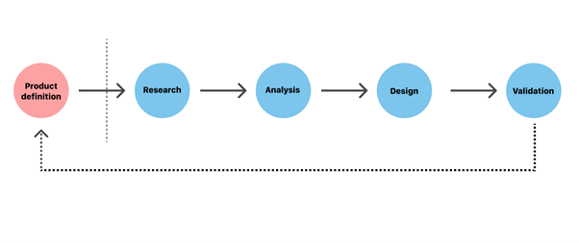

Slide 60
1. Product definition
One of the most important phases in UX design is actually done before the product team creates anything. Before you can build a product, you need to understand its context for existence. The product definition phase sets the foundation for the final product. During this phase, UX designers brainstorm around the product at the highest level (basically, the concept of the product) with stakeholders.
This phase usually includes:
Stakeholder interviews: interviewing key stakeholders to gather insights about business goals.
Value proposition mapping: thinking about the key aspects and value propositions of the product: what it is, who will use it, and why they will use it. Value propositions help the team and stakeholders create consensus around what the product will be and how to match user and business needs.
Concept sketching: creating an early mockup of the future product (can be low-fidelity paper sketches of the product’s architecture).
This phase typically ends up with a project kick-off meeting. The kick-off meeting brings all the key players together to set proper expectations both for the product team and stakeholders. It covers the high-level outline of the product purpose, team structure (who will design and develop the product), communication channels (how they will work together), and what stakeholders’ expectations are (such as KPIs and how to measure the success of the product).

Slide 61
2. Product research
Once you’ve defined your idea, the product team moves to the research phase. This phase typically includes both user research and market research. Seasoned product designers think of research as a good investment—good research informs design decisions and investing in research early in the process can save a lot of time and money down the road.
Individual in-depth interviews (IDI). A great product experience starts with a good understanding of the users. In-depth interviews provide qualitative data about the target audience, such as their needs, wants, fears, motivations, and behavior.
Competitive research. Research helps UX designers understand industry standards and identify opportunities for the product within its particular niche.

Slide 62
3. Analysis
The aim of the analysis phase is to draw insights from data collected during the research phase, moving from “what” users want/think/need to “why” they want/think/need it. During this phase, designers confirm that the team’s most important assumptions are correct.
This phase of the UX process usually includes:
Creating user personas. Personas are fictional characters that represent the different user types for your product. As you design your product, you can reference these personas as realistic representations of your target audience.

Slide 63
4. Design
When users’ wants, needs, and expectations from a product are clear, product designers move to the design phase. At this step, product teams work on various activities, from creating information architecture (IA) to the actual UI design. An effective design phase is both highly collaborative (it requires active participation from all team players involved in product design) and iterative (meaning that it cycles back upon itself to validate ideas).

Slide 64
Validation (Testing)
Validation is an essential step in the design process because it helps teams understand whether their design works for their users. Usually, the validation phase starts after the high-fidelity design is ready, since testing with high-fidelity designs provides more valuable feedback from end-users). During a series of user testing sessions, the team validates the product with both stakeholders and end-users

Slide 65
VISUAL DESIGN PRINCIPLES
Visual-design principles inform us how design elements such as line, shape, color, grid, or space go together to create well-rounded and thoughtful visuals.
This article defines 5 visual-design principles that impact UX:
Scale
Visual hierarchy
Balance
Contrast
Gestalt

Slide 66
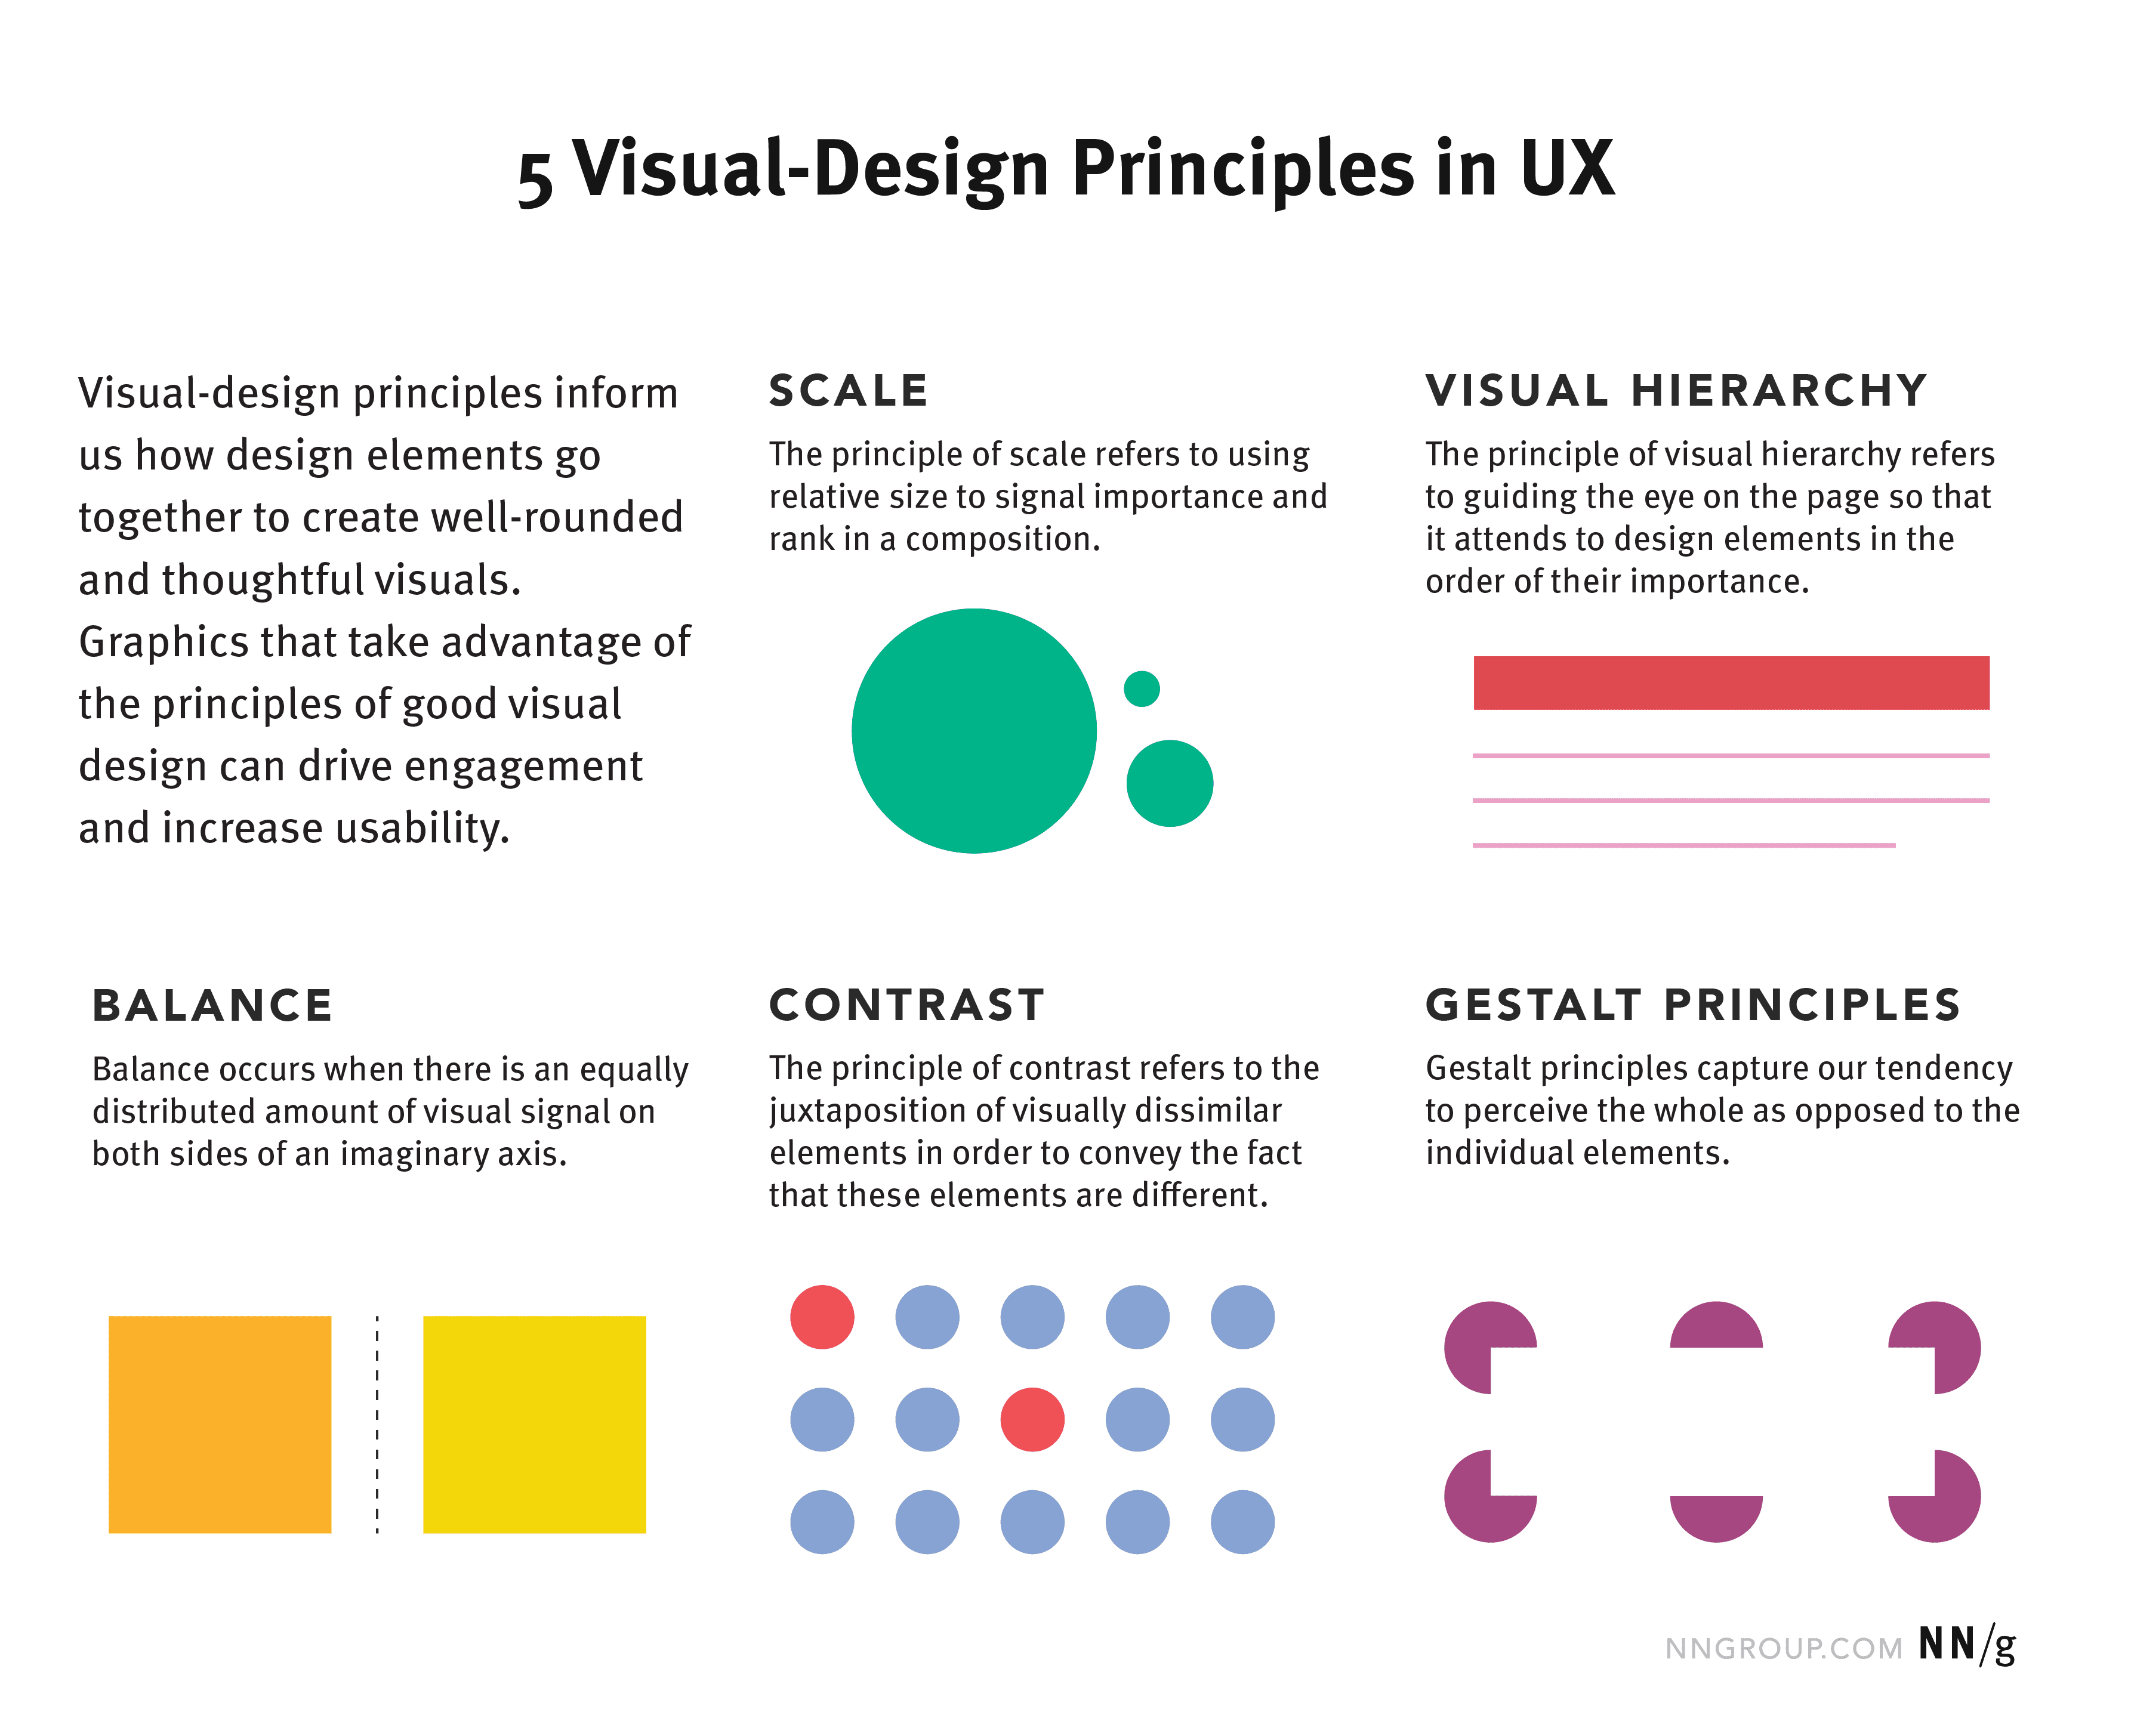

Slide 67
1. Scale
This principle is commonly used: almost every good visual design takes advantage of it.
Definition: The principle of scale refers to using relative size to signal importance and rank in a composition.
In other words, when this principle is used properly, the most important elements in a design are bigger than the ones that are less important. The reason behind this principle is simple: when something is big, it’s more likely to be noticed.
A visually pleasing design generally uses no more than 3 different sizes. Having a range of differently sized elements will not only create variety within your layout, but it will also establish a visual hierarchy (see next principle) on the page. Be sure to emphasize the most important aspect of your design by making them biggest.

Slide 68
.
2. Visual Hierarchy
A layout with a good visual hierarchy will be easily understood by your users.
Definition: The principle of visual hierarchy refers to guiding the eye on the page so that it attends to different design elements in the order of their importance.
Visual hierarchy can be implemented through variations in scale, value, color, spacing, placement, and a variety of other signals.
Visual hierarchy controls the delivery of the experience. If you have a hard time figuring out where to look on a page, it’s more than likely that its layout is missing a clear visual hierarchy.

Slide 69
3. Balance
Balance is like a seesaw: instead of weight, you are balancing design elements.
Definition: The principle of balance refers to a satisfying arrangement or proportion of design elements. Balance occurs when there is an equally distributed (but not necessarily symmetrical) amount of visual signal on both sides of an imaginary axis going through the middle of the screen. This axis is often vertical but can also be horizontal.

Slide 70
4.Contrast
This is another commonly used principle that makes certain parts of your design stand out to your users.
Definition: The principle of contrast refers to the juxtaposition of visually dissimilar elements in order to convey the fact that these elements are different (e.g., belong in different categories, have different functions, behave differently).
In other words, contrast provides the eye with a noticeable difference (e.g., in size or color) between two objects (or between two sets of objects) in order to emphasize that they are distinct.
The principle of contrast is often applied through color. For example, red is frequently used in UI designs, especially on iOS, to signify deleting. The bright color signals that a red element is different from the rest

Slide 71
5. Gestalt Principles
These are a set of principles that were established in the early twentieth century by the Gestalt psychologists. They capture how humans make sense of images.
Definition: Gestalt principles explain how humans simplify and organize complex images that consist of many elements, by subconsciously arranging the parts into an organized system that creates a whole, rather than interpreting them as a series of disparate elements. In other words, Gestalt principles capture our tendency to perceive the whole as opposed to the individual elements

Slide 72
INFORMATION DESIGN AND VISUALIZATION
Information design is data used as a storytelling tool. It’s data with a purpose. Therefore, Information visualizations are more about informing the viewer about a data set and it’s specific parts. Conclusions have already been made for that data, and it’s being presented in a snackable design. Data visualizations are raw data visualized in a way that permits the viewer to make their own conclusions. Data visualizations can be ever-evolving visuals with new data and information being added regularly.
They can also include data from a specific point in time and can be organized in a way that inspires a distinctive reaction. Nevertheless, it can still be analyzed and direct viewers to their own conclusions. Not only must information be presented in a clear manner, but users also need to navigate the information without it being overwhelming or confusing.

Slide 74
INTERACTION DESIGN
The purpose of interaction design is to create a great user experience. That’s why most of the UI disciplines require understanding and hands-on experience of interaction design principles. After all, it’s about designing for the entire interconnected system: the device, interface, context, environment, and people. Interaction designers strive to create meaningful relationships between people and the products and services they use. It may include computers, mobile devices, gadgets, appliances, and more.

Slide 75
The 10 most important interaction design principles are-
UX: Match user experience and expectations
Consistent design: Maintain consistency throughout the application
Functionality: Follow functional minimalism
Cognition: Reduce cognitive loads/mental pressure to understand the application
Engagement: Design interactively such that it keeps the user engaged.
User control: Allow the user to control, trust, and explore
Perceivability: Invite interactions through intuitions and interactive media
Learnability: Make user interactions easy to learn and remember
Error handling: Take care to prevent errors, if they occur make sure to detect and recover them.
Affordability: Simulate actions by taking inspiration from usual and physical world interactions.

Slide 76
PROTOTYPING TOOLS
By definition, a prototype is an early sample, model, or release of a product built for the purpose of testing a concept or process. Generally, the prototype is used to evaluate a new product or concept design for its usefulness in the real world.
Additionally, the main motive behind a prototype is to validate the design with your target market by collecting feedback that will guide you during product development.
Importance of prototyping
Would you ever walk into a stakeholder meeting to present your concept without first getting customer feedback? Hopefully not. Doing so could undermine your credibility and capacity to defend your design.
Communicating and justifying the value, look, and feel of your product to stakeholders can be a challenge. But through prototyping you’re able to:
Better depict the intent of your final design
Defend your design decisions with customer feedback
Save time and money by making changes early rather than in final development
Feel confident that what your presenting has a strong product-market fit

Slide 77
USABILITY TEST
Usability testing refers to evaluating a product or service by testing it with representative users. Typically, during a test, participants will try to complete typical tasks while observers watch, listen and takes notes. The goal is to identify any usability problems, collect qualitative and quantitative data and determine the participant's satisfaction with the product.
To run an effective usability test, you need to develop a solid test plan, recruit participants , and then analyze and report your findings.
Benefits of Usability Testing
Usability testing lets the design and development teams identify problems before they are coded. The earlier issues are identified and fixed, the less expensive the fixes will be in terms of both staff time and possible impact to the schedule. During a usability test, you will:
Learn if participants are able to complete specified tasks successfully and
Identify how long it takes to complete specified tasks
Find out how satisfied participants are with your Web site or other product
Identify changes required to improve user performance and satisfaction
And analyze the performance to see if it meets your usability objectives

Slide 78
USER INTERFACE COMPONENTS
When designing your interface, try to be consistent and predictable in your choice of interface elements. Whether they are aware of it or not, users have become familiar with elements acting in a certain way, so choosing to adopt those elements when appropriate will help with task completion, efficiency, and satisfaction.
Interface elements include but are not limited to:
Input Controls: checkboxes, radio buttons, dropdown lists, list boxes, buttons, toggles, text fields, date field
Navigational Components: breadcrumb, slider, search field, pagination, slider, tags, icons
Informational Components: tooltips, icons, progress bar, notifications, message boxes, modal windows
Containers: accordion

Slide 79
TOOLS AND PROCESSES
Process improvement plays a very vital role in organizations. Lean Six Sigma is one means for creating a deployment that is to improve the business. Through this effort there should be an upbeat task of determining, analyzing and enhancing an organization’s business processes to achieve optimization and new quality standards. Process improvement efforts should entail a systematic approach that adheres to a certain methodology, where the specific approaches to accomplish this task may differ.
When undertaking a process improvement endeavor, more efficient outcomes are expected. Process improvement may involve a sequence of actions to attain new objectives and goals, like improving performance, reducing costs and elevating profits. Such actions may follow a particular technique or methodology to increase the odds of achieving successful results.

Slide 80
1. Process Baselining and Process Comparisons In general, four processes can be involved when baselining and determining how a process is performing relative to other similar processes:
• Building Baseline – Create a clear business or organizational baseline. This effort would entail defining the baseline about all the business aspects.
• Do Comparison – Observe how organizational baselines compare. Comparisons should be made statistically; e.g., a hypothesis of equality of means for a process-output response. • Determine Baseline Differences – Identify the reasons for differences in performance. This understanding can help an organization make adjustments to their process so that performance improves.
2. Flowcharting Flowcharting is one of the best tools for documenting and understanding various processes in an organization. This tool allows for a detailed breakdown of processes to activities and events, as well as describing logical relationships. By using flowcharts, an organization can better understand the work efforts involved in all their undertakings.

Slide 81
3. Value-Stream Mapping Value stream mapping provides a picture of work flow and information flow in an end-to-end process. One can evaluate a current state and propose a future state that reduces organizational waste; i.e., transport, inventory, motion, waiting, over production, over processing, and defects.
4. Cause and Effect Analysis Problems can often be resolved by first exploring all possible causes. A cause-and-effect analysis approach provides a structure for this assessment, which involves the consideration of six areas or causes that can contribute to a characteristic response or effect: materials, machine, method, personnel, measurement and environment.
5. Hypothesis Testing Hypothesis testing consists of a null hypothesis and alternative hypothesis where, for example, a null hypothesis indicates equality between two process outputs and an alternative hypothesis indicates non-equality. Through a hypothesis test, a decision is made on whether to reject a null hypothesis or not reject a null hypothesis, with a risk of making an erroneous decision. Hypothesis tests can take many formats. It is important to select the most appropriate hypothesis test for each situation.

